Slide 1
Nursing Assistant Information Session

Slide 2
Academic Admission Requirements
through Accuplacer or Course Completion

Slide 3
Apply to Pima Community College
to begin your journey as a student
Visit www.pima.edu to Apply Online Today

Slide 4
Admission Requirements for the
Nursing Assistant Program
Test | Minimum Score | Placement
Reading | Minimum Score of 236 | Nursing Assistant
Quantitative Reasoning | Minimum Score of 200 | Nursing Assistant
Writeplacer | Minimum Score of 4 | Nursing Assistant
You may also utilize your Pima transcripts with the following completed courses with a “C” or better:
ACL 080 or higher
WRT 090 or higher
ICS 080 or higher
IMPORTANT: Multiple Measures may not be utilized for acceptance into the Pima Community College Nursing Assistant Program (High School Transcripts, Pima EdReady).

Slide 5
Select the links for helpful educational resources to
prepare you for your Accuplacer examinations.
General Accuplacer information
http://accuplacer.collegeboard.org/students
Mathematics
https://pima.edu/admission/placement-testing/practice-tests.html
Study Guides
https://pima.edu/admission/placement-testing/practice-tests.html
Grammar and Writing
www.readtheory.org
Khan Academy
https://www.khanacademy.org/
Knowledge Review for the
Accuplacer Assessment:

Slide 6
Clinical
Requirements

Slide 7
Program Admission Requirements:
Physical Assessment and Vaccinations
An Immunization and Health Declaration form must be completed by a physician, nurse practitioner, or qualified examiner within the past year and submitted to the Nursing Department before beginning any clinical learning experiences in the Nursing Assistant course. Additionally, the following requirements must be fulfilled before starting the program:
Documentation of a negative T-SPOT or QuantiFERON-TB Gold current through the last day of the course
MMR (measles, mumps, rubella) x 2 or a positive serology (titer) results indicating immunity.
Hepatitis B immunization (series of two or three injections), or positive or reactive serology (titer) results indicating immunity.
Varicella (chickenpox) x 2 or positive serology (titer) results indicating immunity.
Tdap (tetanus, diphtheria, pertussis) immunization for adults, one injection within the last ten (10) years that does not expire until after the last day of the current course.
Influenza vaccination, one injection within the last seasonal year.
Please hold the control button and click the link to access the Health Declaration form:
Health Declaration form

Slide 8
Nursing Assistant Program Requirements Continued
CARDIOPULMONARY (CPR CERTIFICATION)
Current Basic Life Support Provider CPR certification that does not expire until after the last day of the course. The card must clearly state “BLS Provider” and that the provider is the “American Heart Association”. CPR certification is good for two years. Online CPR courses are not accepted.
CRIMINAL BACKGROUND CHECK
Arizona Department of Public Safety (DPS) fingerprint clearance card that is in good standing and does not expire before the last day of the course.
The application can be obtained from the Arizona Department of Public Safety website.
Digital fingerprinting is recommended as it typically yields faster results compared to manual fingerprinting.

Slide 9
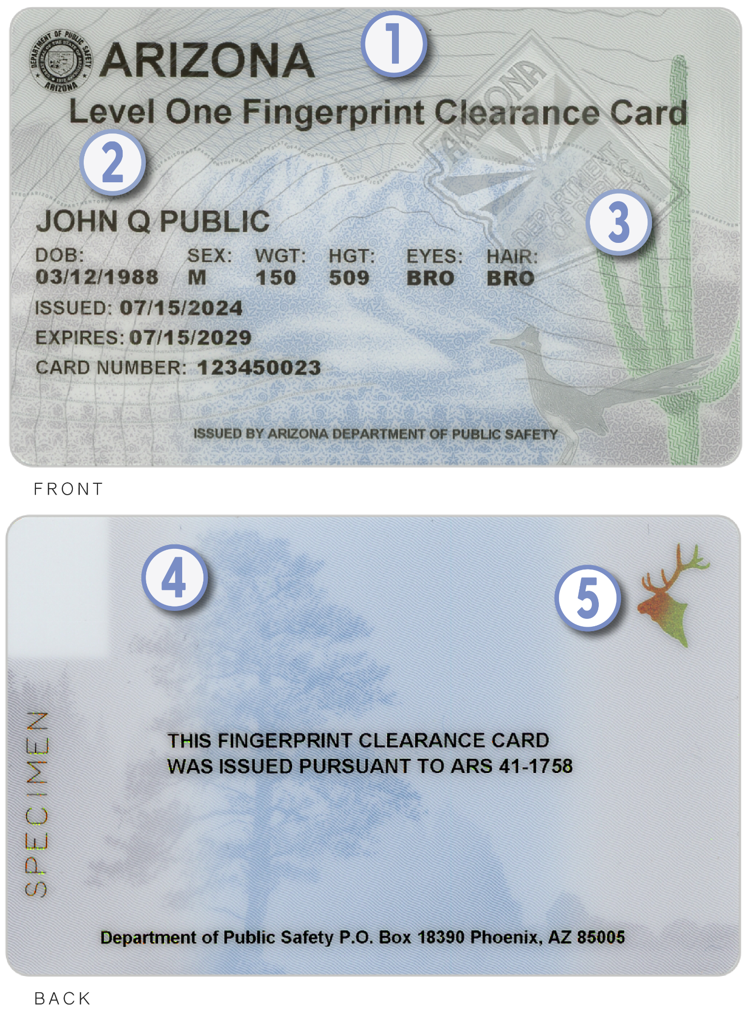
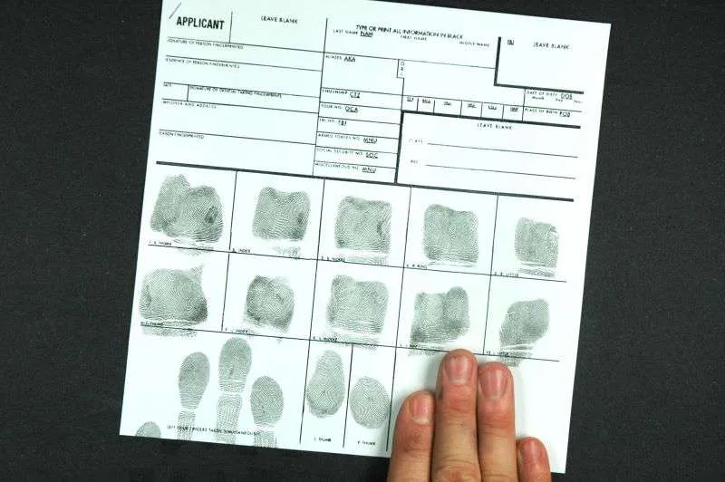
Criminal Background Check
Level 1 Fingerprint Clearance Card Example
(Information on card is not an actual individual and is for informational purposes only)
We do not accept this document

Slide 10
Drug tests are conducted by a College designated laboratory. Detailed instructions on obtaining your drug test will be provided AFTER acceptance into the Nursing Assistant program.
Drug Screening must be completed prior to your first day of class
Positive drug test results will result in a denial letter from the program.
Please take any prescription medications with you to your appointment.
Drug Screening

Slide 11
Nursing Assistant
Program

Slide 12
Important:
To apply for the Certified Nursing Assistant program at Pima Community College, you must be enrolled with the college and have a student “A” number assigned.
If your declared major is “Practical Nursing” you may enter the program through the Practical Nursing pathway.
If your major is not “Practical Nursing” you are required to change your major to “Nursing Assistant” for the duration of the Nursing Assistant program.
Please consult with your advisor for further guidance.

Slide 13
Nursing Assistant Program Hours and Time Commitment
Nursing assistant students should expect to be in class, laboratories and clinical settings 100% of the scheduled time. The clinical laboratory may require preparation, so ANY additional activities should be kept at a minimum. Optional but recommended 4 hours of open skills lab time is offered every other week.
The NRA 101 course is designed to prepare students to take the Arizona State Board of Nursing Certification Exam for Nursing Assistants. Proctored by TMU Headmaster. The program is divided into three components: lecture, college skills lab, and clinical lab. Total instructional hours for the program are equal to 141 hours, divided as follows:
Lecture | 4 hours/day x 12 days | Total: 48 hours
Skills Lab | 4 hours/day x 12 days | Total: 48 hours
Clinical Lab | 9 hours/day x 5 days | Total: 45 hours
Total Hours: |  | 141
ANY additional activities or employment should be considered as influential to the success in the Nursing Assistant program and should be considered by the student when planning for success . Students must be aware that the Nursing Assistant program is rigorous and demands a significant time commitment. Students are encouraged to develop a study plan and time management plan PRIOR to entry.

Slide 14
Suggested Classes for the
Nursing Education Pathway
The following classes are NOT mandatory, but are recommended to enhance your academic success:
HRP 100 – Success in Health Professions
HRP 101 – Medical Terminology
HRP 103 – Basic Health Professional Skills

Slide 15
Approximate Costs for
Nursing Assistant Students
Nursing Assistant Program Costs
Physical Exam / Immunizations | Varies
CPR / First Aid | $60.00
Drug Screen | $40.00
Textbooks | $200.00
Tuition & State Exam Fees | $1,207.00
Fingerprint Clearance Card | $67.00
MyClinicalExchange | $20.00
*Course Total Estimated Cost: $1,514.00
*Costs are estimates and subject to change.

Slide 16
Other Equipment for the
Nursing Assistant Program
PCC Uniform, shoes
Stethoscope
Watch with Second Hand
Manual Blood Pressure Cuff
Non-erasable BLACK Ballpoint Pen
Laptop Computer
Gait Belt (Strongly Advised)
May be required at certain facilities
Students are advised to research costs carefully before enrolling.

Slide 17
Required Textbook
Requirements
You must purchase required eBooks (available online or at the bookstore) and the mandatory hard copy workbook BEFORE orientation. An optional hard copy textbook is also available.
Allow 1–3 weeks to obtain your books.
Link:
https://lippincottdirect.lww.com/NursingEducationPimaCommunityCollegeDesertVistaCampus-Spring2026

Slide 18
Financial Resources
Note: You are only eligible for financial aid if you are registered and admitted
into the Practical Nursing program at Pima Community College.
ARIZONA@WORK: Please contact a representative for more information at Arizona at Work
Scholarships: visit www.pima.edu/scholarships for more information.
Additional Organizations that provide financial resources: SEED / TANF / WIOA
Acceptance into the program is on a first come, first serve basis. You are not accepted until you receive a “Letter of Acceptance” via your Pima student email.

Slide 19
Application for the
Pima Community College
Certified Nursing Assistant Program
Summer Cohort: Window to apply is April 1st to April 30th
Fall Cohort: Window to apply is June 1st to June 30th
Spring Cohort: Window to apply is October 1st to October 31st
Applications will not be accepted outside of these windows. You will need to reapply if you miss the window.
Prospective students will receive a response via their Pima student email within two weeks AFTER the closing window.
Acceptance into the program is on a first come, first serve basis. You are not accepted until you receive
a “Letter of Acceptance” via your Pima student email.

Slide 20
Conclusion of Presentation
For any question or concerns please do not hesitate
to contact the Nursing Assistant Program Manager at
pcc-NRAadmissions@pima.edu.
Kindly allow 24-48 business hours for a response.
Wishing you the best of luck on your educational journey!

